Slide 1
Marketing Data A/B Testing Results
Presented by:
Denis Hovsepian
Hasmik Tumanyan
Maria Gyulamiryan
Alyona Babayan
Angin Mgrdunts

Slide 2
The Objective of the Testing
Comparing two versions of a marketing campaign to determine which one performs better

Slide 3
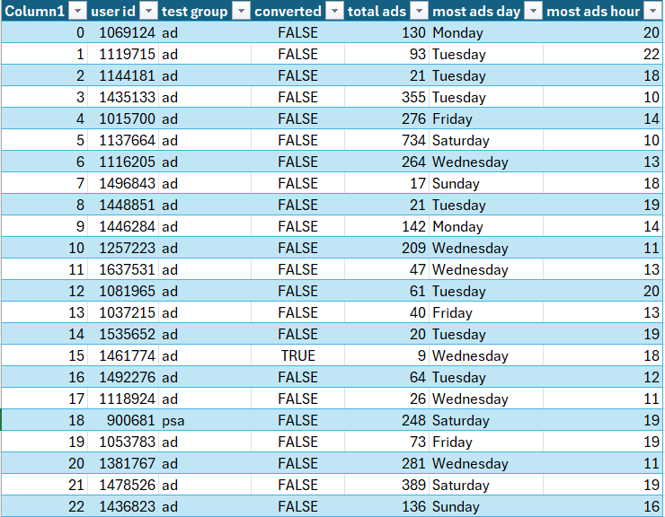
Data Used for the Testing

Slide 4
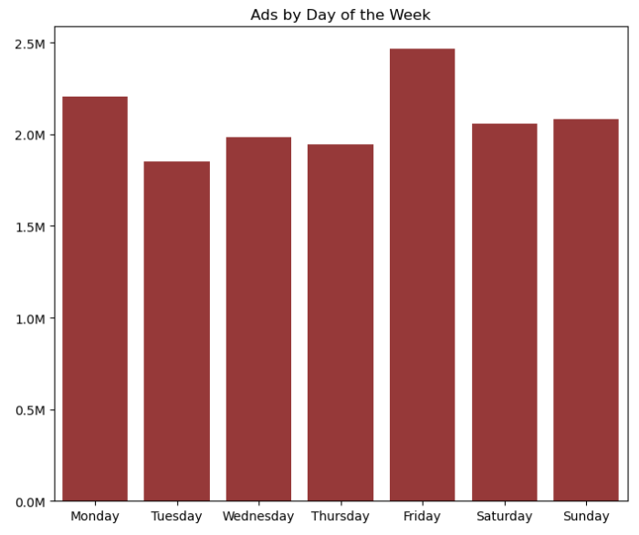
Total Amount of Ads: 14,597,182

Slide 5
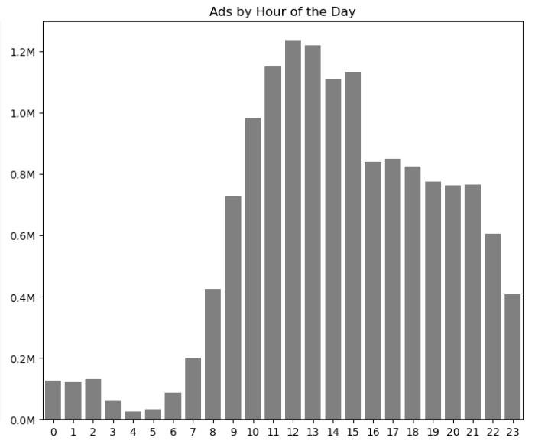

Slide 6
Statistical information
Day of the week with most ads: Friday
Day of the week with least ads: Tuesday
Hour of the day with most ads: 12
Hour of the day with least ads: 4
Max total ads for Ad Group in one day: 2065
Min total ads for Ad Group in one day: 1
Max total ads for PSA Group in one day: 907
Min total ads for PSA Group in one day: 1

Slide 7
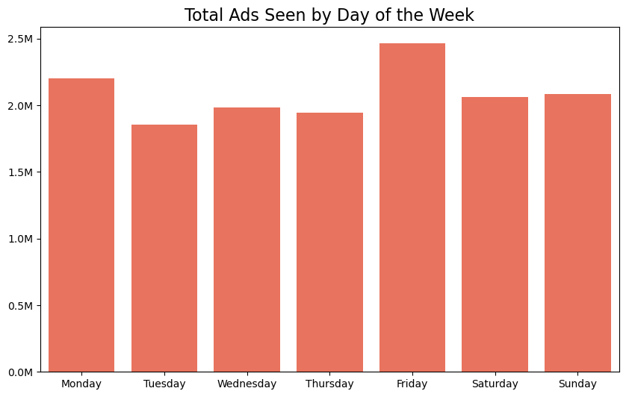
AD Group Conversion Rate by the Day of Week

Slide 8
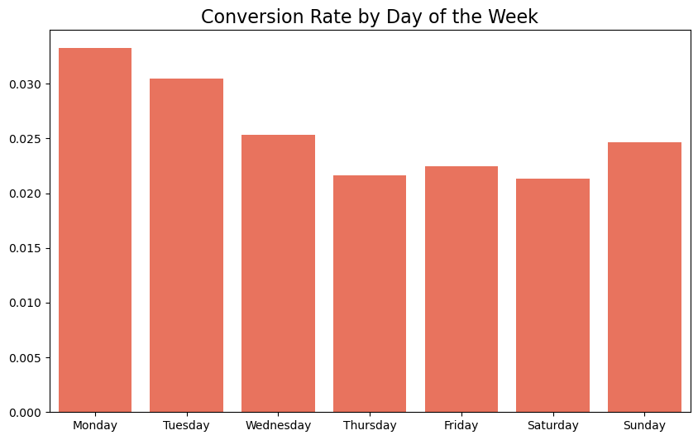

Slide 9
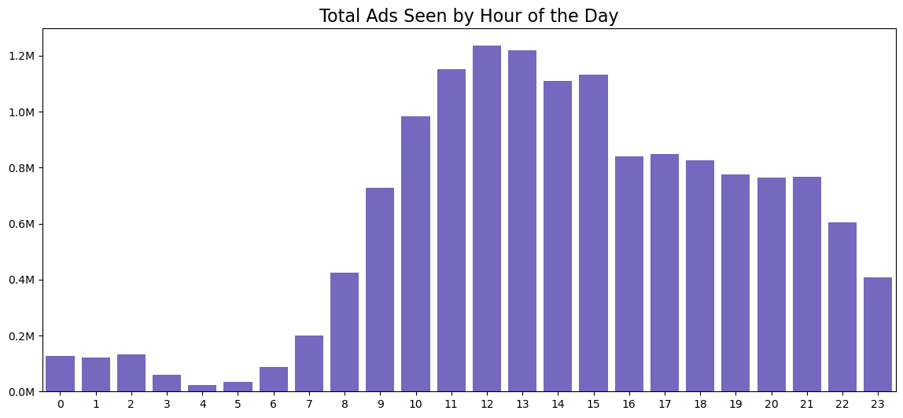
AD Group Conversion Rate by Hour

Slide 10
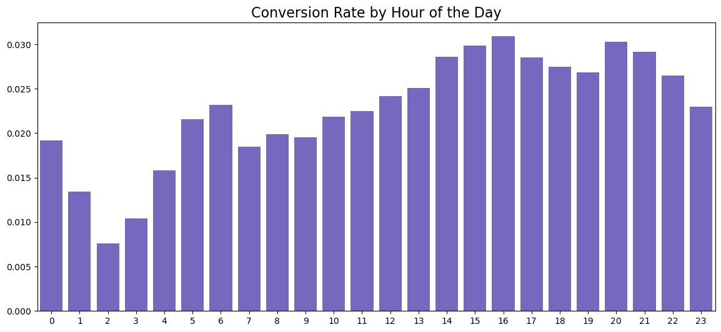

Slide 11
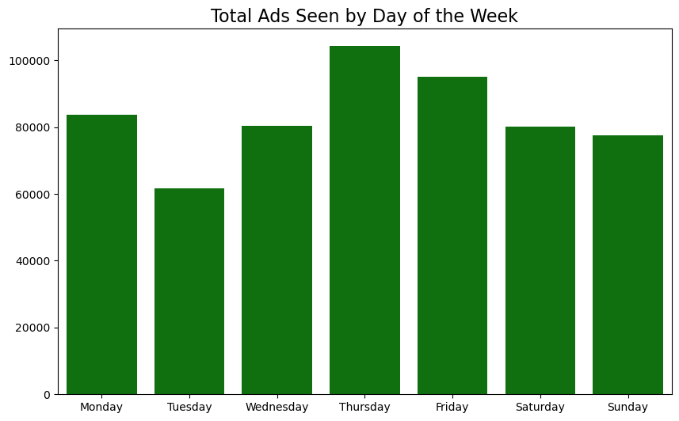
PSA Group Conversion Rate by the Day of Week

Slide 12
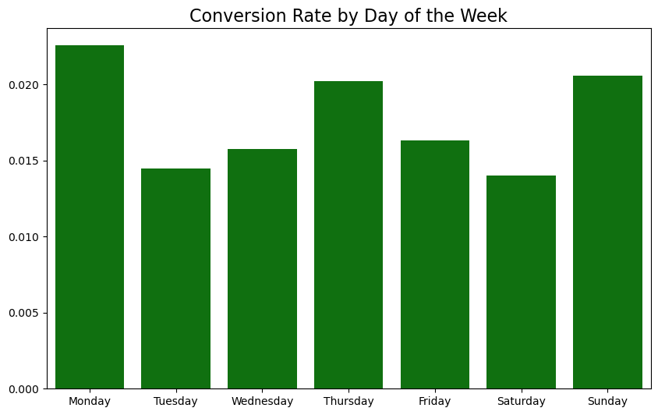

Slide 13
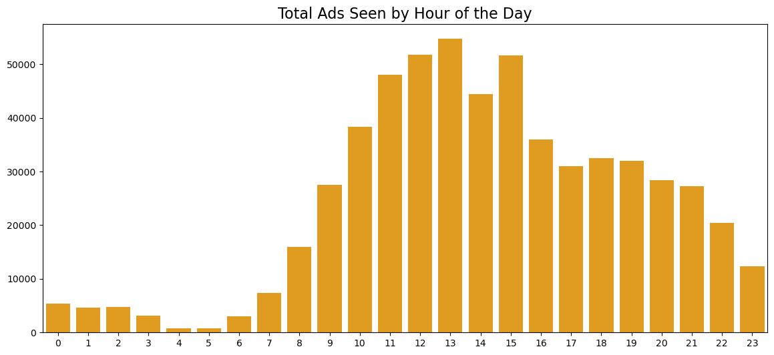
PSA Group Conversion Rate by Hour

Slide 14
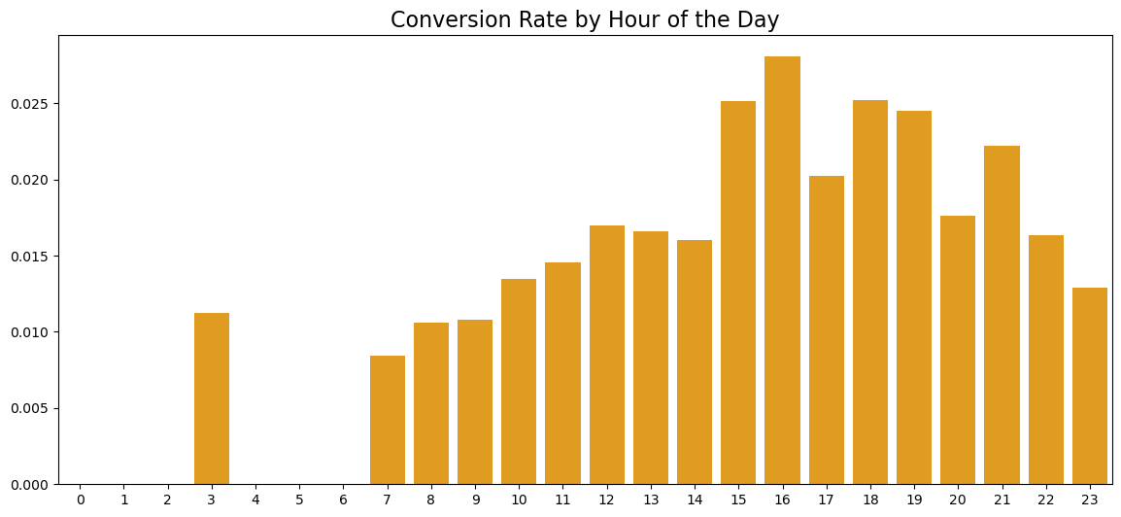

Slide 15
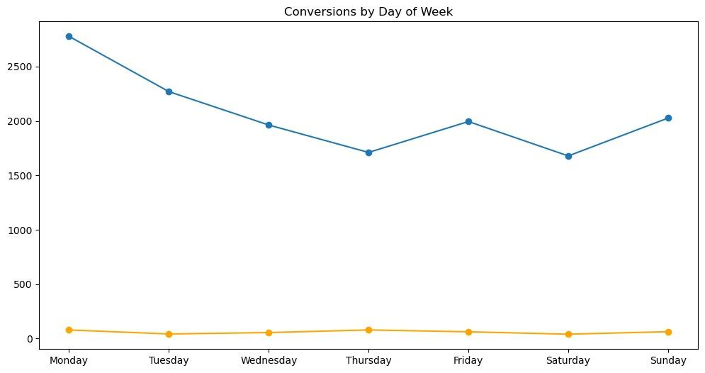
Comparison of Conversion Amounts and Rates of AD and PSA Groups by Day of the Week

Slide 16
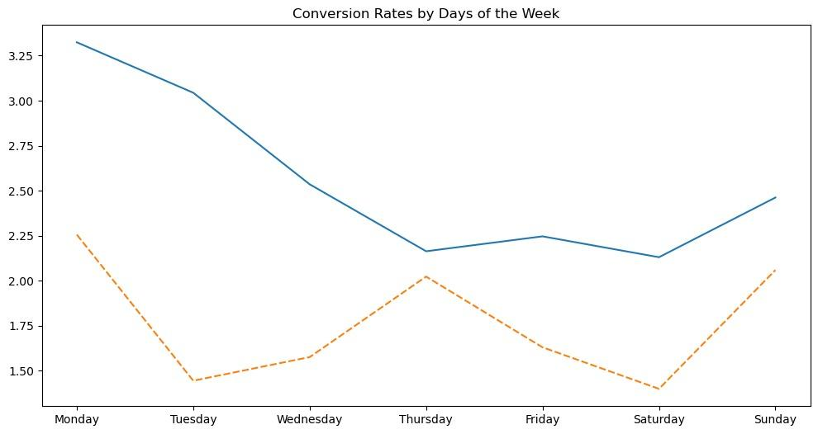

Slide 17
The Results of Z-Test for the Conversion Rates by Week
Monday | Tuesday | Wednesday | Thursday | Friday | Saturday | Sunday
Ad Group Conversion Rate: 0.0332 (3.32%) PSA Group Conversion Rate: 0.0226 (2.26%) Z-statistic: 3.48 p-value: 2.5391e-04 Critical Z-value: 1.64 Better Performing Group: Ad Group | Ad Group Conversion Rate: 0.0304 (3.04%) PSA Group Conversion Rate: 0.0144 (1.44%) Z-statistic: 4.97 p-value: 3.3172e-07 Critical Z-value: 1.64 Better Performing Group: Ad Group | Ad Group Conversion Rate: 0.0254 (2.54%) PSA Group Conversion Rate: 0.0158 (1.58%) Z-statistic: 3.56 p-value: 1.8821e-04 Critical Z-value: 1.64 Better Performing Group: Ad Group | Ad Group Conversion Rate: 0.0216 (2.16%) PSA Group Conversion Rate: 0.0202 (2.02%) Z-statistic: 0.59 p-value: 2.7738e-01 Critical Z-value: 1.64 Better Performing Group: No significant difference | Ad Group Conversion Rate: 0.0225 (2.25%) PSA Group Conversion Rate: 0.0163 (1.63%) Z-statistic: 2.53 p-value: 5.7844e-03 Critical Z-value: 1.64 Better Performing Group: Ad Group | Ad Group Conversion Rate: 0.0213 (2.13%) PSA Group Conversion Rate: 0.0140 (1.40%) Z-statistic: 2.67 p-value: 3.7419e-03 Critical Z-value: 1.64 Better Performing Group: Ad Group | Ad Group Conversion Rate: 0.0246 (2.46%) PSA Group Conversion Rate: 0.0206 (2.06%) Z-statistic: 1.41 p-value: 7.8593e-02 Critical Z-value: 1.64 Better Performing Group: No significant difference

Slide 18
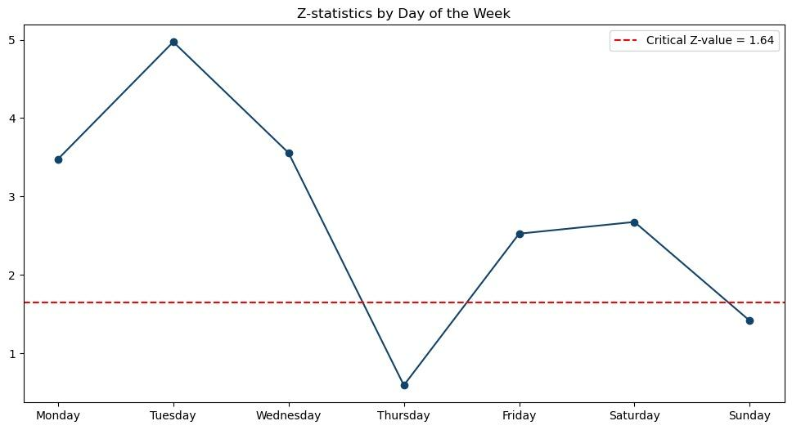

Slide 19
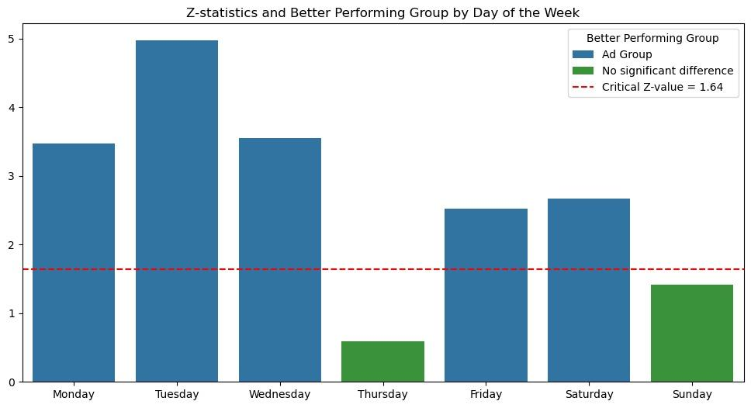

Slide 20
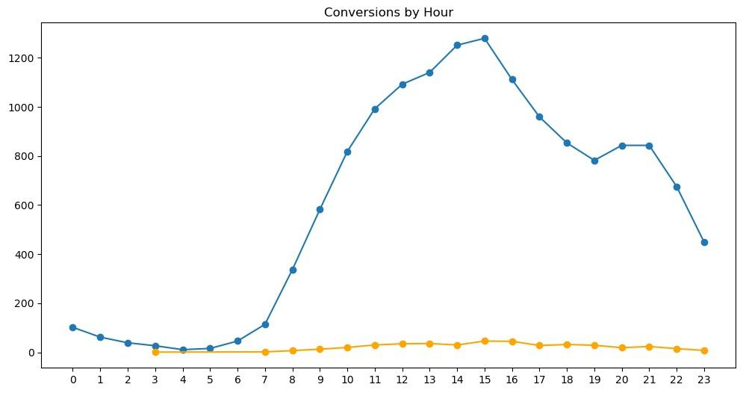
Comparison of Conversion Amounts and Rates of AD and PSA Groups by Hours

Slide 21
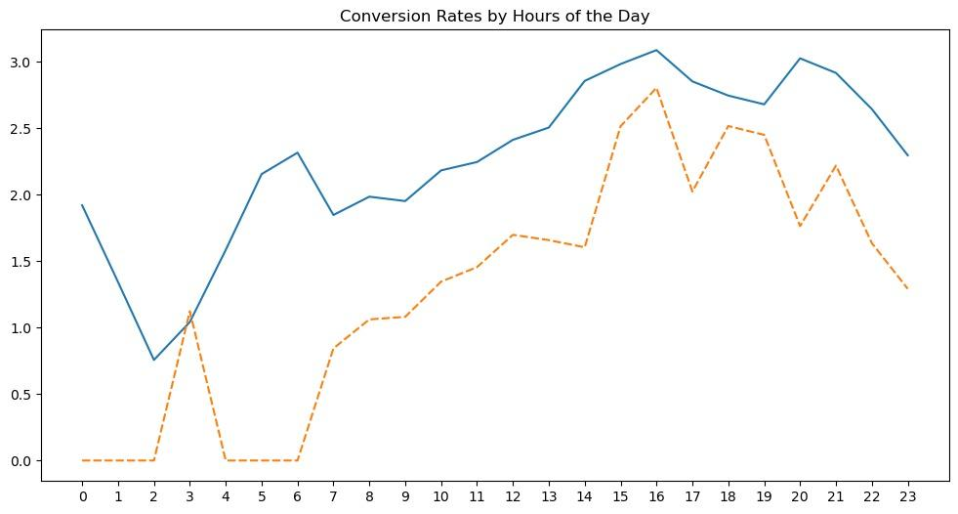

Slide 22
The Results of Z-Test for the Conversion Rates by Hour
0 | Ad Group Conversion Rate: 0.0192 (1.92%) PSA Group Conversion Rate: 0.0000 (0.00%) Z-statistic: 2.11 p-value: 1.7521e-02 Critical Z-value: 1.64 Better Performing Group: Ad Group
1 | Ad Group Conversion Rate: 0.0134 (1.34%) PSA Group Conversion Rate: 0.0000 (0.00%) Z-statistic: 1.60 p-value: 5.5318e-02 Critical Z-value: 1.64 Better Performing Group: No significant difference
2 | Ad Group Conversion Rate: 0.0076 (0.76%) PSA Group Conversion Rate: 0.0000 (0.00%) Z-statistic: 1.17 p-value: 1.2003e-01 Critical Z-value: 1.64 Better Performing Group: No significant difference
3 | Ad Group Conversion Rate: 0.0104 (1.04%) PSA Group Conversion Rate: 0.0112 (1.12%) Z-statistic: -0.07 p-value: 5.2949e-01 Critical Z-value: 1.64 Better Performing Group: No significant difference
4 | Ad Group Conversion Rate: 0.0159 (1.59%) PSA Group Conversion Rate: 0.0000 (0.00%) Z-statistic: 0.67 p-value: 2.5101e-01 Critical Z-value: 1.64 Better Performing Group: No significant difference
5 | Ad Group Conversion Rate: 0.0216 (2.16%) PSA Group Conversion Rate: 0.0000 (0.00%) Z-statistic: 0.71 p-value: 2.3832e-01 Critical Z-value: 1.64 Better Performing Group: No significant difference
6 | Ad Group Conversion Rate: 0.0232 (2.32%) PSA Group Conversion Rate: 0.0000 (0.00%) Z-statistic: 1.40 p-value: 8.0374e-02 Critical Z-value: 1.64 Better Performing Group: No significant difference
7 | Ad Group Conversion Rate: 0.0185 (1.85%) PSA Group Conversion Rate: 0.0084 (0.84%) Z-statistic: 1.14 p-value: 1.2760e-01 Critical Z-value: 1.64 Better Performing Group: No significant difference
8 | Ad Group Conversion Rate: 0.0199 (1.99%) PSA Group Conversion Rate: 0.0106 (1.06%) Z-statistic: 1.68 p-value: 4.6267e-02 Critical Z-value: 1.64 Better Performing Group: Ad Group
9 | Ad Group Conversion Rate: 0.0195 (1.95%) PSA Group Conversion Rate: 0.0108 (1.08%) Z-statistic: 2.16 p-value: 1.5431e-02 Critical Z-value: 1.64 Better Performing Group: Ad Group

Slide 23
10 | Ad Group Conversion Rate: 0.0218 (2.18%) PSA Group Conversion Rate: 0.0135 (1.35%) Z-statistic: 2.18 p-value: 1.4611e-02 Critical Z-value: 1.64 Better Performing Group: Ad Group
11 | Ad Group Conversion Rate: 0.0225 (2.25%) PSA Group Conversion Rate: 0.0146 (1.46%) Z-statistic: 2.39 p-value: 8.4759e-03 Critical Z-value: 1.64 Better Performing Group: Ad Group
12 | Ad Group Conversion Rate: 0.0241 (2.41%) PSA Group Conversion Rate: 0.0170 (1.70%) Z-statistic: 2.08 p-value: 1.8735e-02 Critical Z-value: 1.64 Better Performing Group: Ad Group
13 | Ad Group Conversion Rate: 0.0251 (2.51%) PSA Group Conversion Rate: 0.0166 (1.66%) Z-statistic: 2.49 p-value: 6.4656e-03 Critical Z-value: 1.64 Better Performing Group: Ad Group
14 | Ad Group Conversion Rate: 0.0286 (2.86%) PSA Group Conversion Rate: 0.0161 (1.61%) Z-statistic: 3.21 p-value: 6.6229e-04 Critical Z-value: 1.64 Better Performing Group: Ad Group
15 | Ad Group Conversion Rate: 0.0298 (2.98%) PSA Group Conversion Rate: 0.0252 (2.52%) Z-statistic: 1.16 p-value: 1.2396e-01 Critical Z-value: 1.64 Better Performing Group: No significant difference
16 | Ad Group Conversion Rate: 0.0309 (3.09%) PSA Group Conversion Rate: 0.0281 (2.81%) Z-statistic: 0.64 p-value: 2.5980e-01 Critical Z-value: 1.64 Better Performing Group: No significant difference

Slide 24
17 | Ad Group Conversion Rate: 0.0285 (2.85%) PSA Group Conversion Rate: 0.0202 (2.02%) Z-statistic: 1.83 p-value: 3.3987e-02 Critical Z-value: 1.64 Better Performing Group: Ad Group
18 | Ad Group Conversion Rate: 0.0275 (2.75%) PSA Group Conversion Rate: 0.0252 (2.52%) Z-statistic: 0.49 p-value: 3.1171e-01 Critical Z-value: 1.64 Better Performing Group: No significant difference
19 | Ad Group Conversion Rate: 0.0268 (2.68%) PSA Group Conversion Rate: 0.0245 (2.45%) Z-statistic: 0.48 p-value: 3.1564e-01 Critical Z-value: 1.64 Better Performing Group: No significant difference
20 | Ad Group Conversion Rate: 0.0303 (3.03%) PSA Group Conversion Rate: 0.0176 (1.76%) Z-statistic: 2.39 p-value: 8.3761e-03 Critical Z-value: 1.64 Better Performing Group: Ad Group
21 | Ad Group Conversion Rate: 0.0292 (2.92%) PSA Group Conversion Rate: 0.0222 (2.22%) Z-statistic: 1.34 p-value: 8.9622e-02 Critical Z-value: 1.64 Better Performing Group: No significant difference
22 | Ad Group Conversion Rate: 0.0265 (2.65%) PSA Group Conversion Rate: 0.0164 (1.64%) Z-statistic: 1.88 p-value: 2.9774e-02 Critical Z-value: 1.64 Better Performing Group: Ad Group
23 | Ad Group Conversion Rate: 0.0230 (2.30%) PSA Group Conversion Rate: 0.0129 (1.29%) Z-statistic: 1.65 p-value: 4.9114e-02 Critical Z-value: 1.64 Better Performing Group: Ad Group

Slide 25
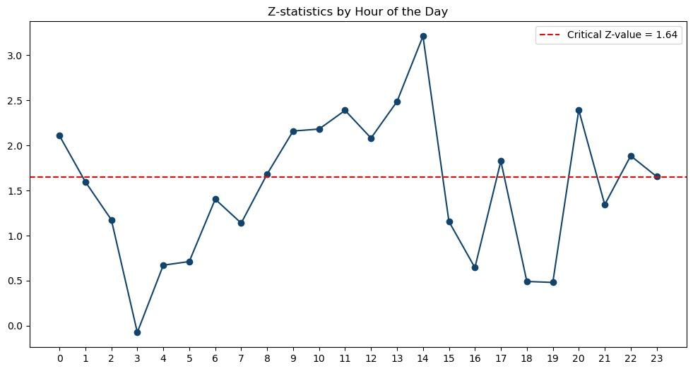

Slide 26
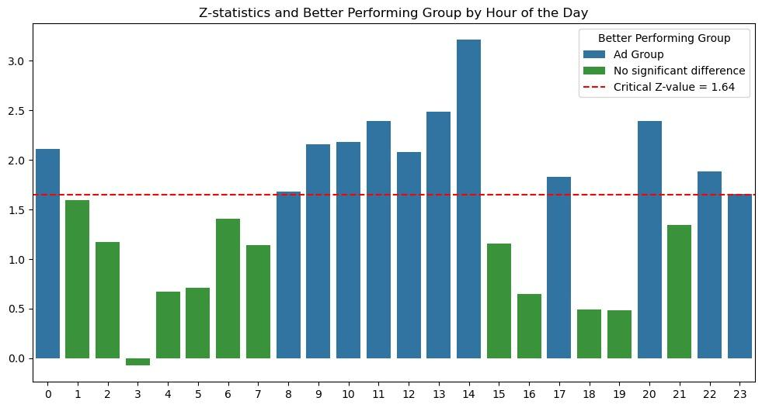

Slide 27
Total Conversions for AD and PSA Groups
Visitors in Ad Group: 564577 | Visitors in PSA Group: 23524
Conversions in Ad Group: 14423 | Conversions in PSA Group: 420

Slide 28
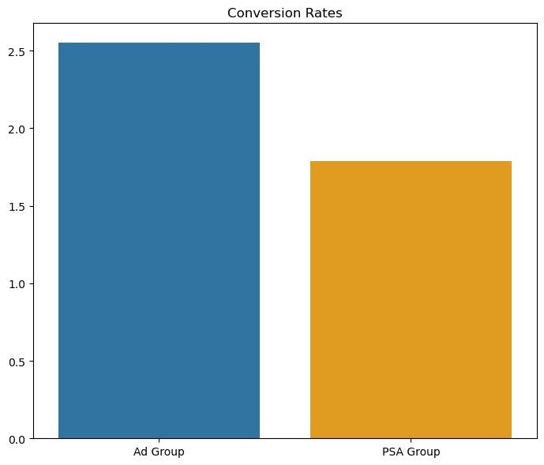

Slide 29
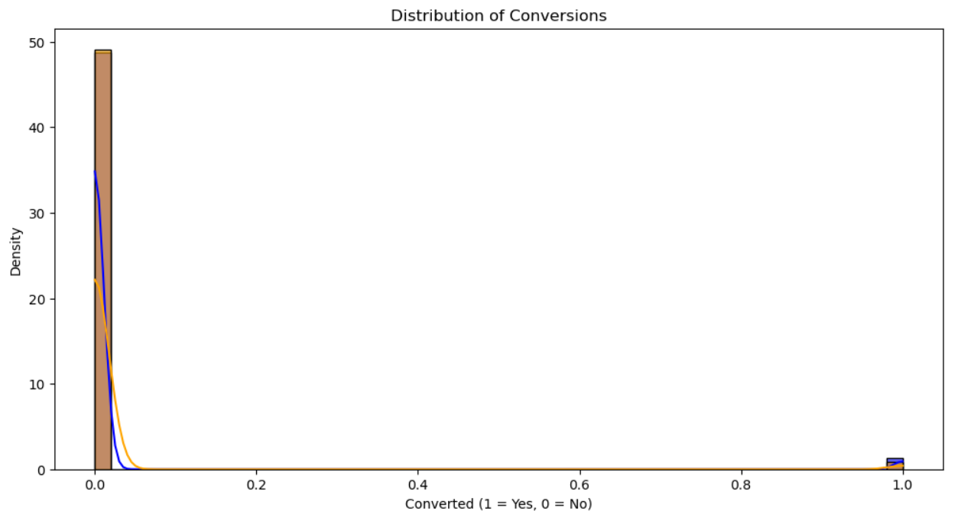

Slide 30
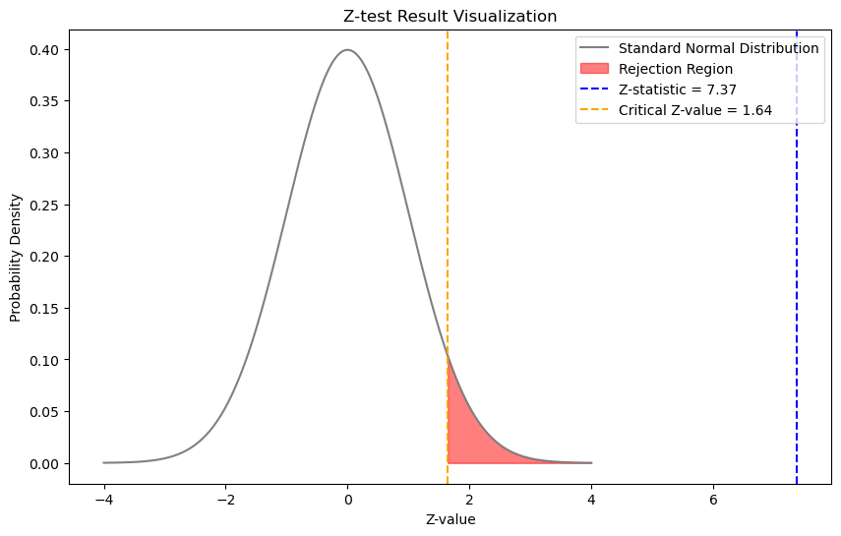

Slide 31
Conclusion
Ad Group Conversion Rate: 0.0255 (2.55%)
Organic Group Conversion Rate: 0.0179 (1.79%)
Z-statistic: 7.37
p-value: 8.5265e-14
Critical Z-value: 1.64
Based on the Z-Test, the Ad group performs significantly better than the PSA group and is considered the better-performing group.

Slide 32
Thank you for your attention……..

